Slide 1
GROUP WORK PROJECT
Machine Learning
Group-6
1. Kamma Jayavardhan (23WU0102083)
2.L Mithra kumar (23WU0102102)
3. M G Samhith (23WU0102108)
4.Malyala Sohan Gupta (23WU0102117)
5.P.Jagadish (23WU0102153)
6.Nikhil ram (23WU0102113)

Slide 2
01
Research based cases studies
Semi-Supervised, Transudative, On line learning, Reinforcement learning

Slide 3
Semi-Supervised Learning
Semi-supervised learning is a class of supervised learning tasks and techniques that also make use of unlabeled data for training - typically a small amount of labeled data with a large amount of unlabeled data. Semi-supervised learning falls between unsupervised learning (without any labeled training data) and supervised learning (with completely labeled training data)

Slide 4
Real life examples of Semi-Supervised Learning
I Self-Training for Celebrity Recognition (Technique: Self-Training)
Scenario: Information on social media data includes the images of celebrities with their names attached to them, and the company is a small one. Unlike the networks studied in the literature on end-to-end learning, they have a significantly larger quantity of unlabeled user-uploaded photos.
Goal: Create a mechanism that allows the celebrities to be tagged automatically within photos that have been user-uploaded.

Slide 5
Transudative Learning
Transductive learning in computer science refers to a type of statistical learning where specific examples from a domain are used directly for reasoning without the need for generalization. It is a more specific approach compared to inductive learning,
so, transductive learning is a paradigm where the model learns directly from labeled training data and makes predictions only for a specific given test set, rather than generalizing to unseen examples.

Slide 6
Real life examples of Transudative learning
Recommendation Systems (Cold Start Problem)
When a new user joins a streaming service (Netflix, Spotify), recommendations are made based on similarities to existing users without fully training a general model.
Instead of predicting preferences for all possible future users, the system focuses on predicting recommendations for the specific new users.

Slide 7
Online Learning
Definition: Online learning is a machine learning paradigm where the model updates continuously as new data arrives, rather than being trained on a fixed dataset all at once.
Key Features:
Real-time updates: The model learns from streaming data instead of a static dataset.
Memory efficiency: Requires less storage as it doesn’t need to store the entire dataset.
Adaptability: Useful for applications where data distribution changes over time (concept drift).
Examples of Online Learning:
Stock Market Prediction: Continuously updating stock price forecasts as new trade data arrives.

Slide 8
Reinforcement Learning
Definition: Reinforcement learning is a learning paradigm where an agent interacts with an environment, learns from rewards and penalties, and takes actions to maximize long-term reward.
Examples of Reinforcement Learning:
Autonomous Vehicles: Self-driving cars learn to navigate by interacting with their surroundings.

Slide 9
References
^ Jump up to:a b Chapelle, Olivier; Schölkopf, Bernhard; Zien, Alexander (2006). Semi-supervised learning. Cambridge, Mass.: MIT Press. ISBN 978-0-262-03358-9.
Jump up^ Scudder, H.J. Probability of Error of Some Adaptive Pattern-Recognition Machines. IEEE Transaction on Information Theory, 11:363–371 (1965). Cited in Chapelle et al. 2006, page 3

Slide 10
Task 2
The goal of this task is to explore and create a research-based APA-referenced solution with real life cases

Slide 11
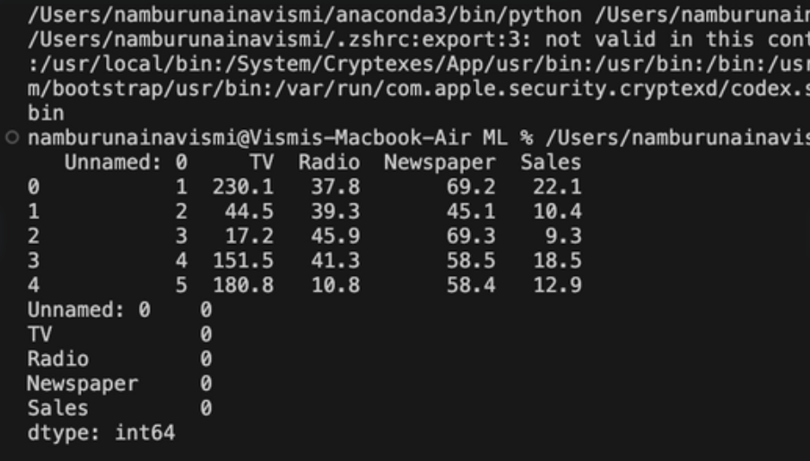
output for the problem
https://www.vedantu.com/geography/relation-between-temperature-and-humidity

Slide 12
03
Competition
(Predict playing tennis when )

Slide 13
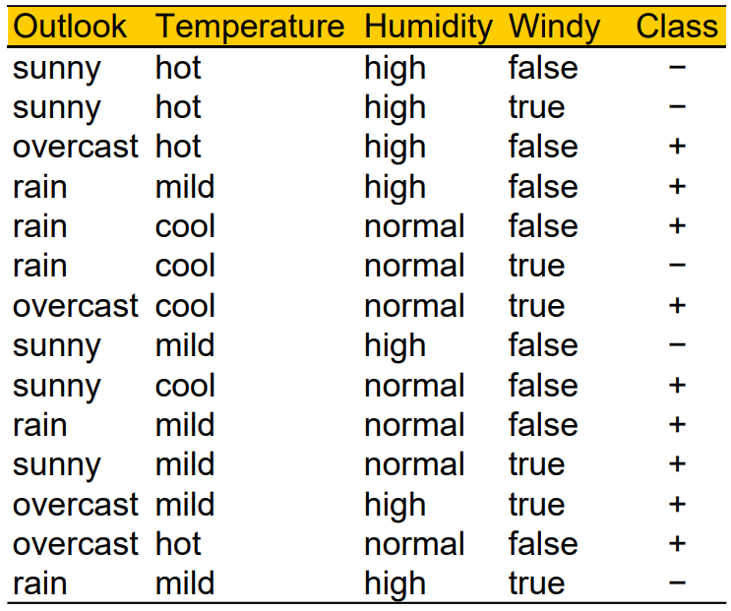
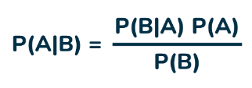
Given Problem
Given below a dataset for which we have to find out whether we play tennis or not for given weather conditions
Using Bayes' Theorem
P(A)= Probability of event A (Tennis played or not)
P(B)= Probability of event B (Weather conditions)
P(A/B)= Probability of event , Occurrence of event B

Slide 14
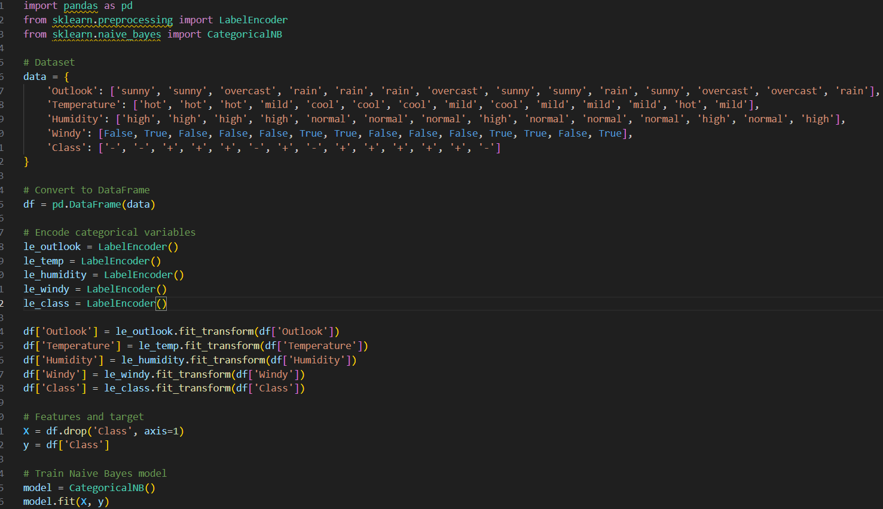
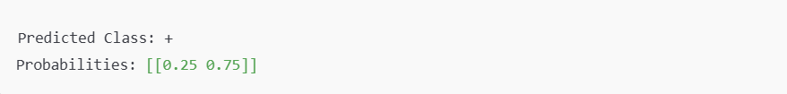
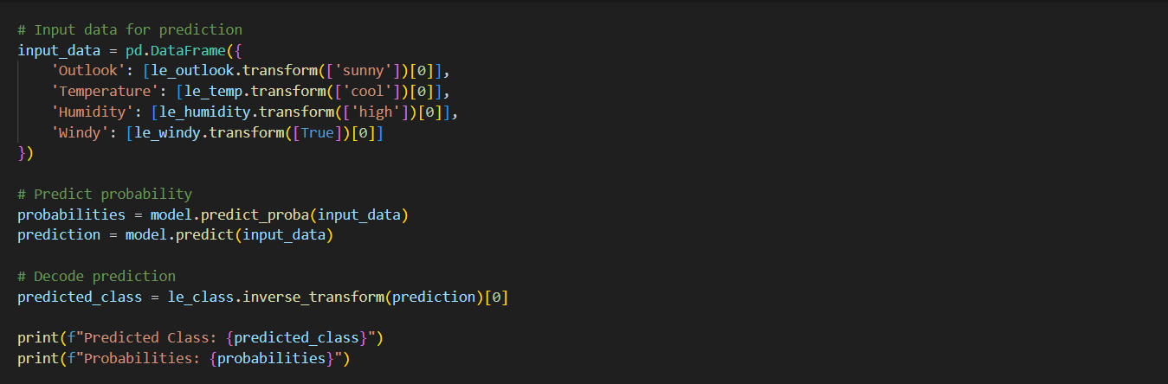
After training the Categorical Naïve Bayes model, it predicts the class for [2, 0, 0, 1].
The output could be:
Predicted Class: +
Probabilities: [[0.25 0.75]]
This means:
Probability of class '-' (0) = 25%
Probability of class '+' (1) = 75%
The predicted class is "+" (Play Tennis).

Slide 15
04
Competition goal

Slide 16
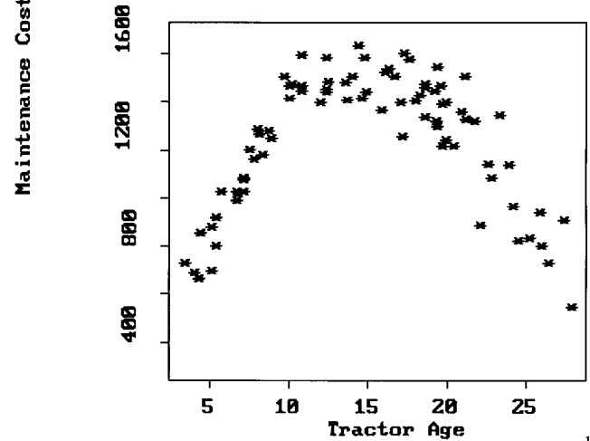
Relation between Tractor Age and Maintenance cost
Given plot

Slide 17
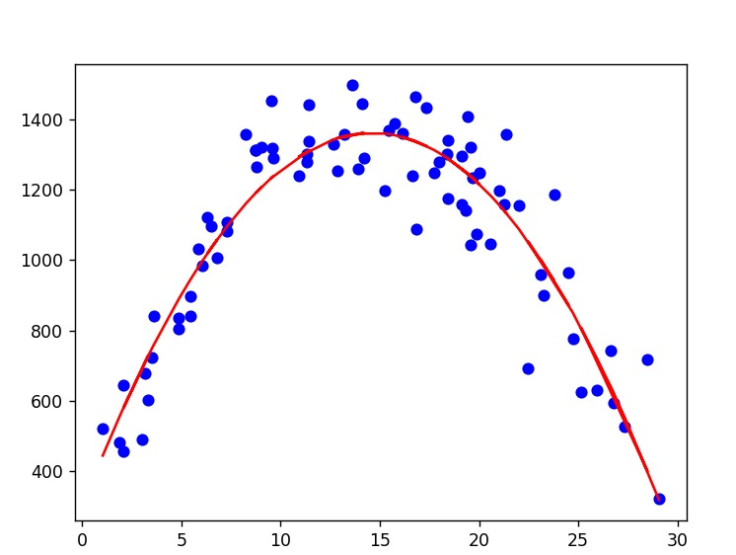
Plot after fitting Non Linear Regression
Polynomial fitting is like drawing the best possible curve through a set of points on a graph, where the curve's shape is determined by a mathematical equation (e.g., a straight line, a parabola).
Polynomial fitting is just a mathematical way to:
Draw the best possible line/curve through your points
Vrdoljak, A. (2013, July). Advanced Visualization for Polynomial Regression Data Fit. International Balkans Conference on Challenges of Civil Engineering.

Slide 18
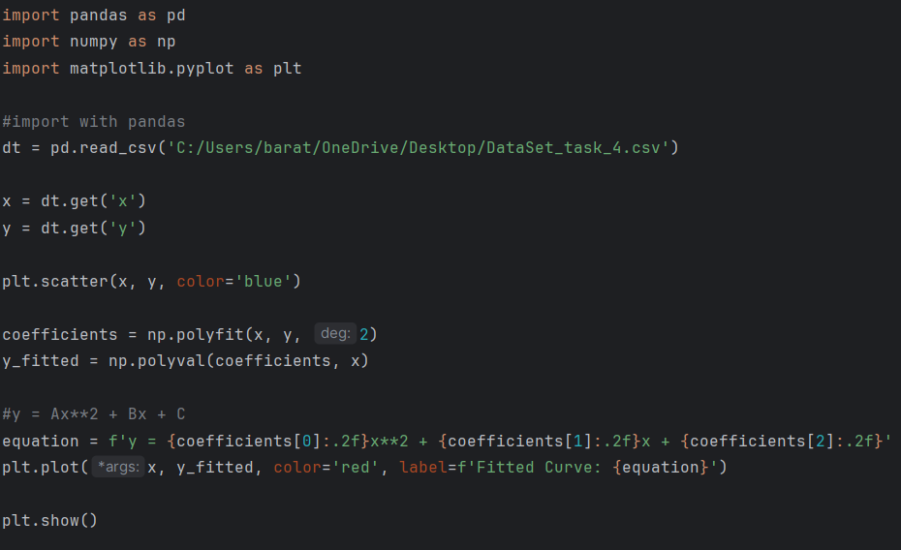
https://www.w3schools.com

Slide 19





1. Importing Libraries
4. Plotting the Data Points
5. Polynomial Fitting
2. Reading Data from a CSV File
6. Formatting the Equation
3. Extracting Columns
7. Plotting the Fitted Curve
8. Displaying the Plot

Slide 20
Thanks!

